Slide 1





MobiCom 2021
Crisp-BP: Continuous Wrist PPG-based Blood Pressure Measurement
Presenter: Yetong Cao
Yetong Cao∗ Huijie Chen† Fan Li∗ Yu Wang‡
*School of Computer Science, Beijing Institute of Technology, China
† School of Computer Science, Beijing University of Technology, China
‡ Department of Computer and Information Sciences, Temple University, USA

Slide 2
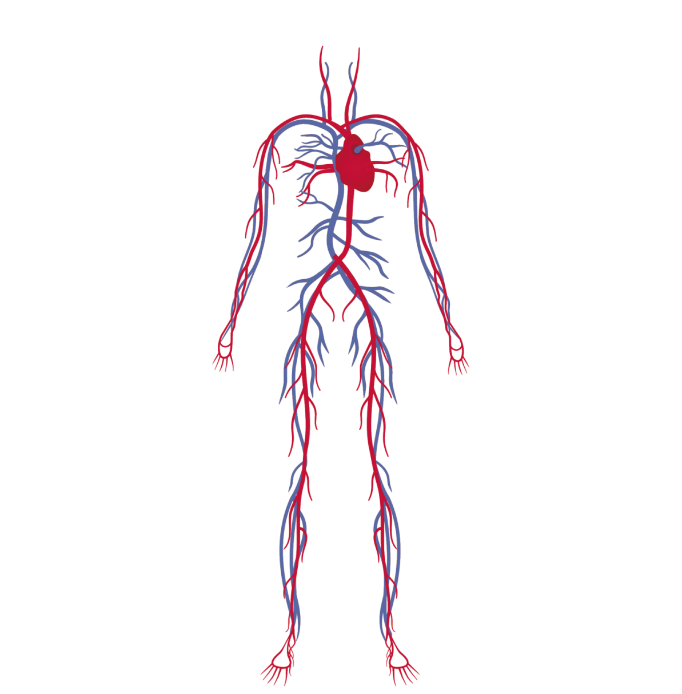
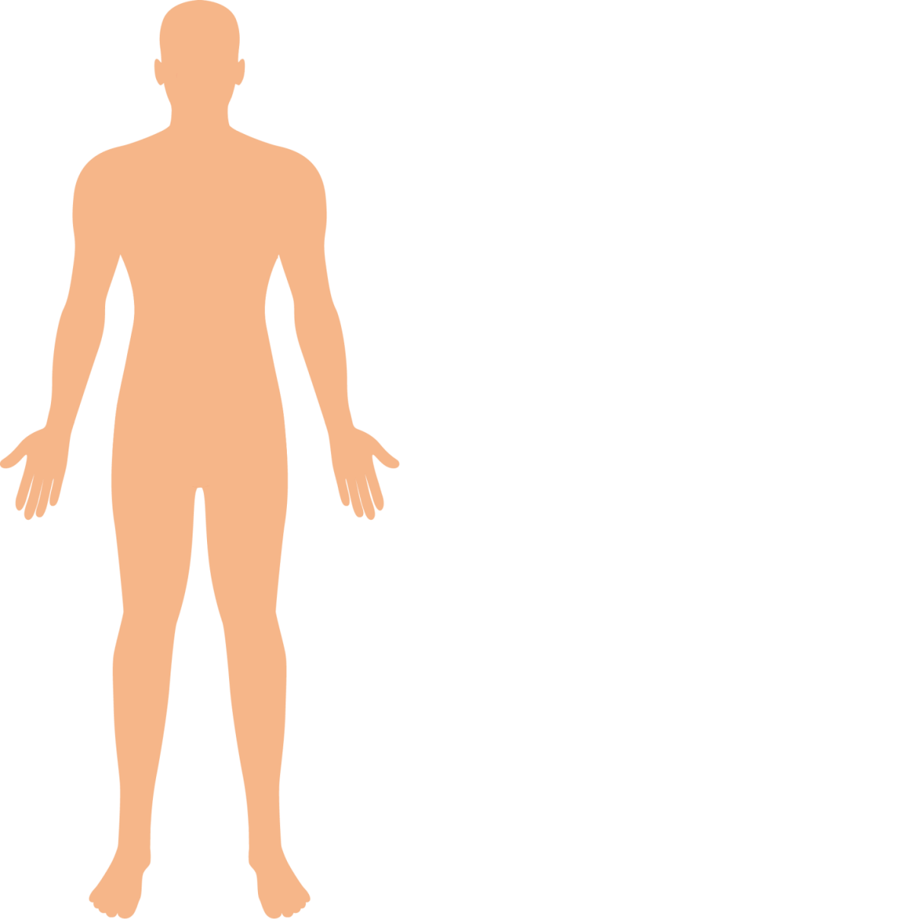
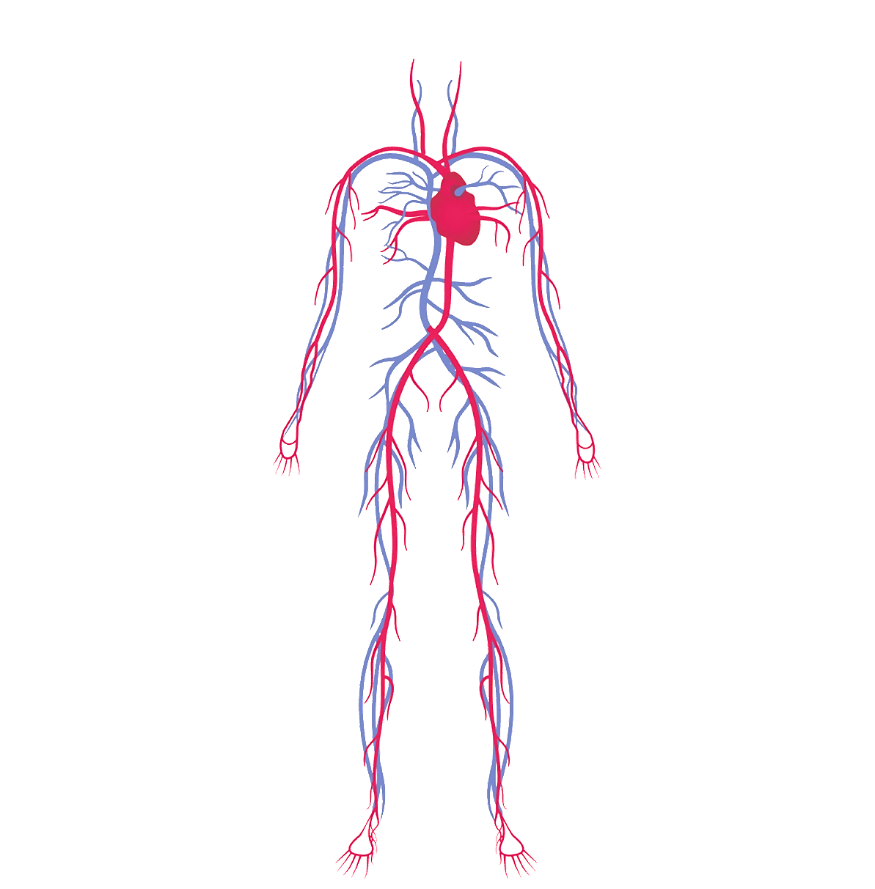

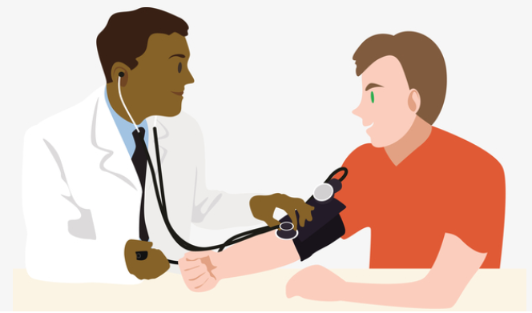
Background
Hypertension: blood pressure is too high
Global health issue: affect 1 in 5 people
Silent killer: no symptoms
Damage the body
Blood pressure is the key signal in the prevention and diagnosis of hypertension.

Slide 3
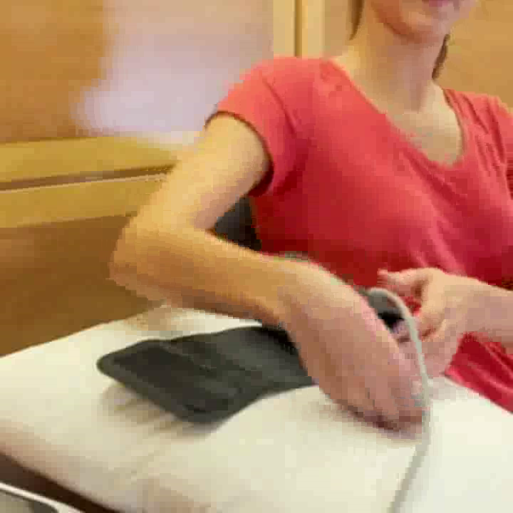
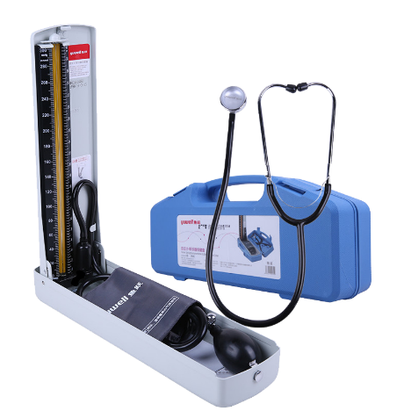
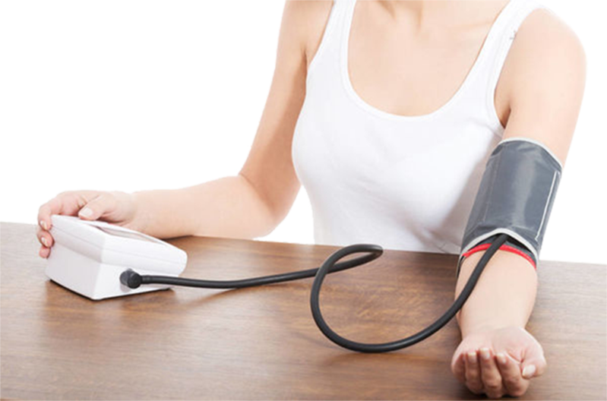
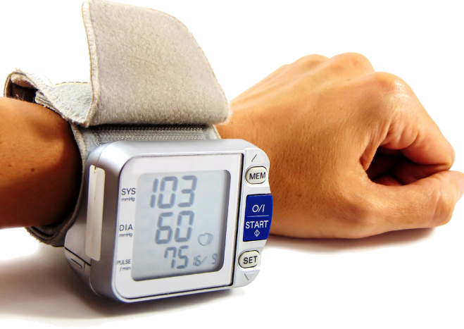
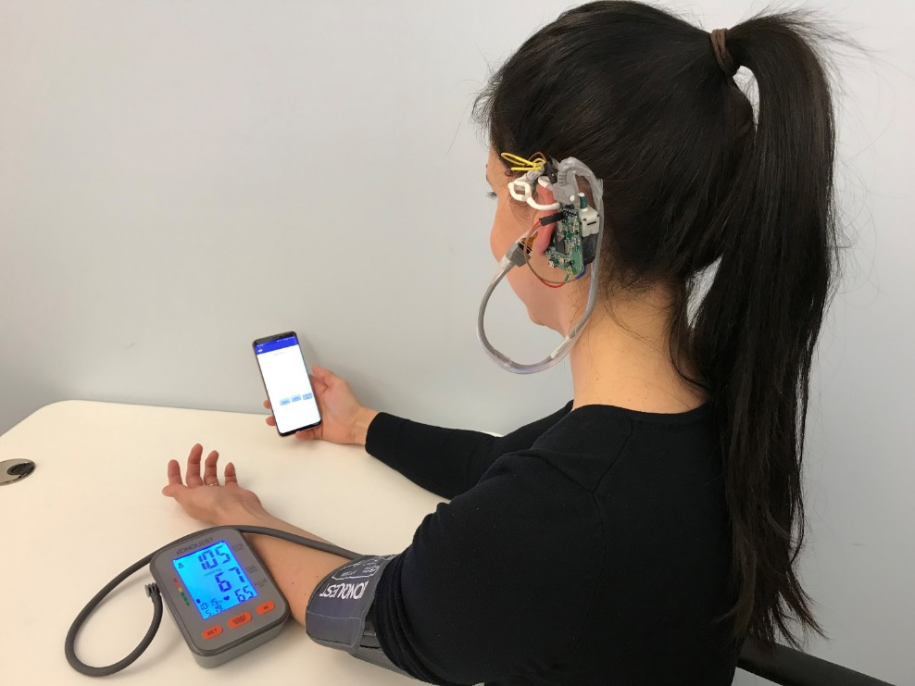
Current BP Monitoring Solutions
Arm-cuff BP Monitoring
Related Solutions
Work discontinuously
https://www.youtube.com/watch?v=N2GZCfJ5lK8

Slide 4
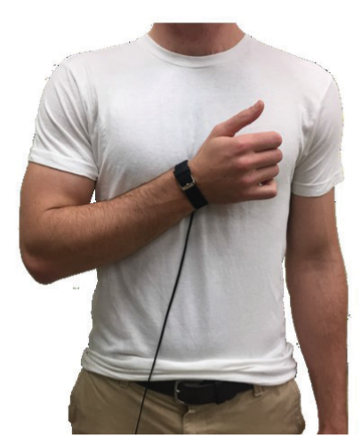
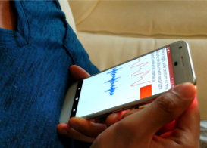
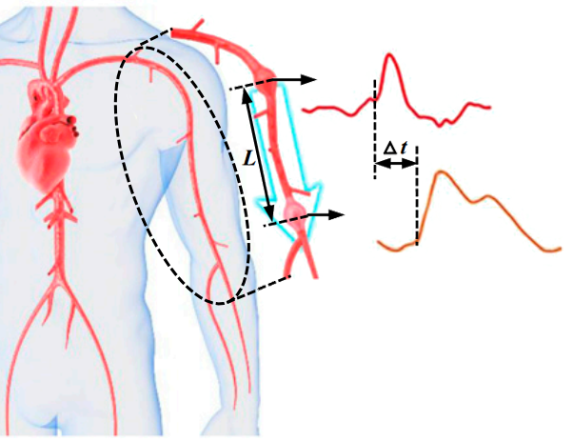
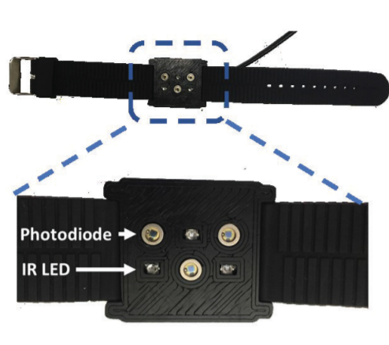
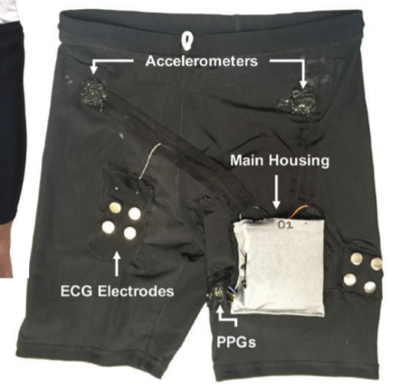


Current BP Monitoring Solutions
Pulse Wave Velocity (PWV)-based BP Monitoring
Related Solutions
Require user effort
$$PWV=\frac{L}{∆t}$$
$$BP=α∙PWV+β$$

Slide 5
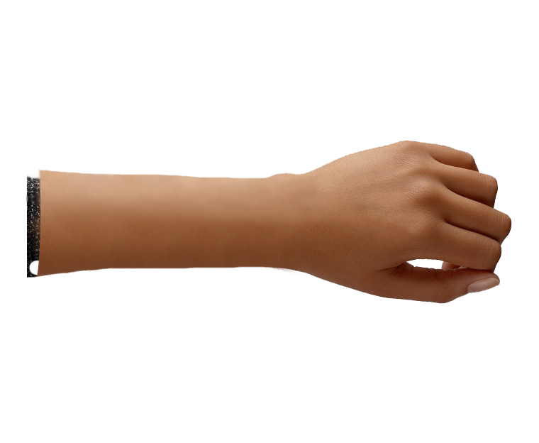
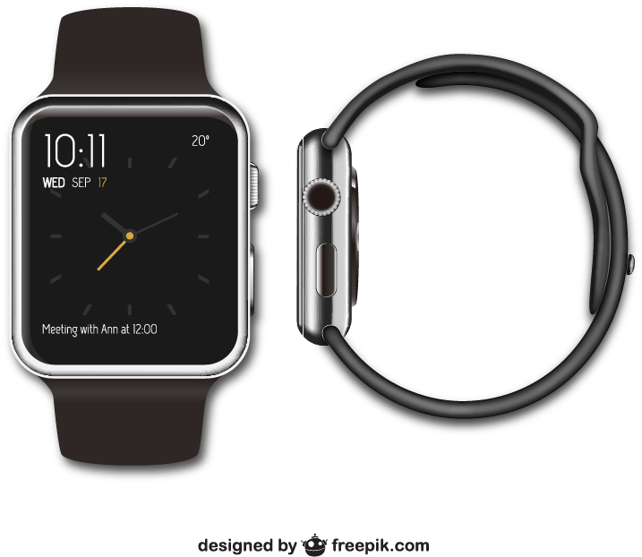

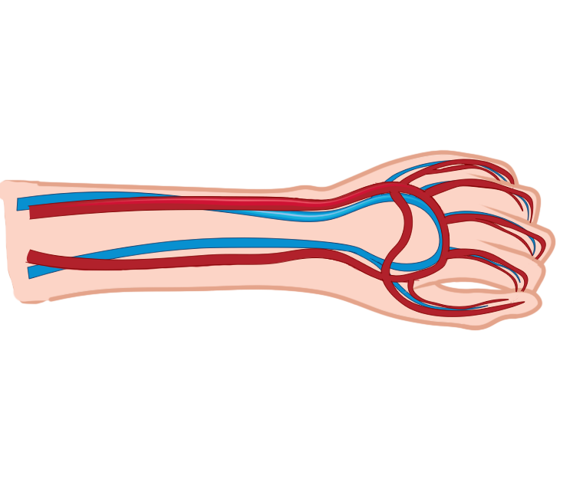
Our Solution
160
90
Low cost
Crisp-BP
Wrist-worn devices
Comfortable
PPG sensor
Convenient
Support long-term monitoring

Slide 6
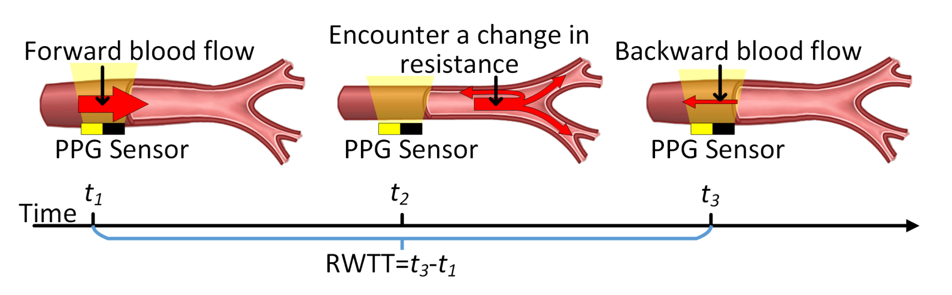
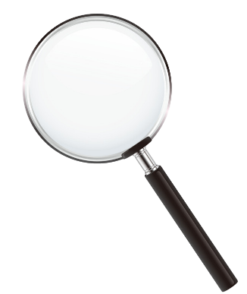
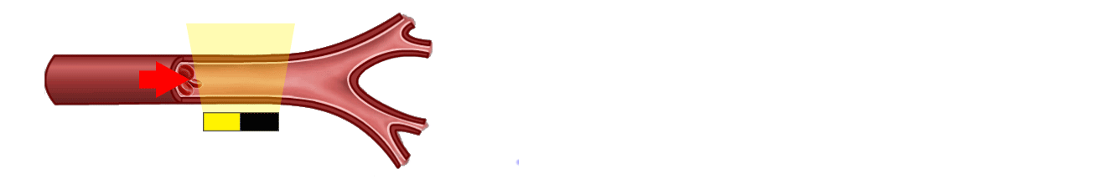
Our Solution
Reflected Wave Transit Time (RWTT)=$t_{3}−t_{1}$

Slide 7
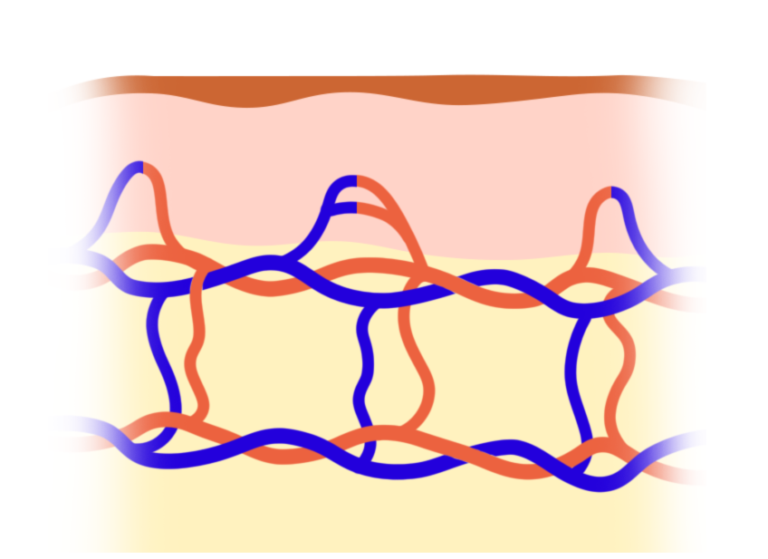

Challenges
160
90
Crisp-BP
How to obtain clean arterial pulse?
Photodetector
PPG LED
Infrared PPG
Capillaries
Capillary Pulse
Arteries
Veins
Arterial Pulse

Slide 8
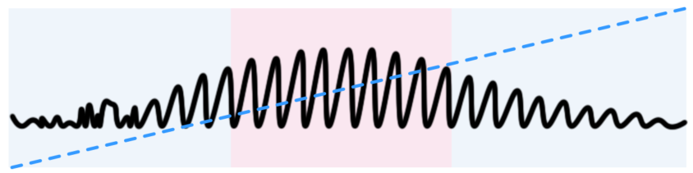
Challenges
How to address contact pressure artifact?
PPG Sensor
Capillary
Low Pressure
Proper Pressure
High Pressure
AC Component
Pressure Level
Artery
Time

Slide 9






Challenges
How to enable accurate and user-independent ABP monitoring?

Slide 10
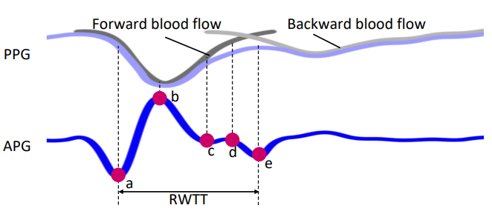
Measuring RWTT using Acceleration PPG

Slide 11
System Overview
Address challenge #1:
Help users maintain appropriate contact pressure
Adjust the writ band
No
Yes
Address challenge #3:
Address challenge #2:
Realize accurate, user-independent ABP estimation
Extract clean arterial pulse

Slide 12
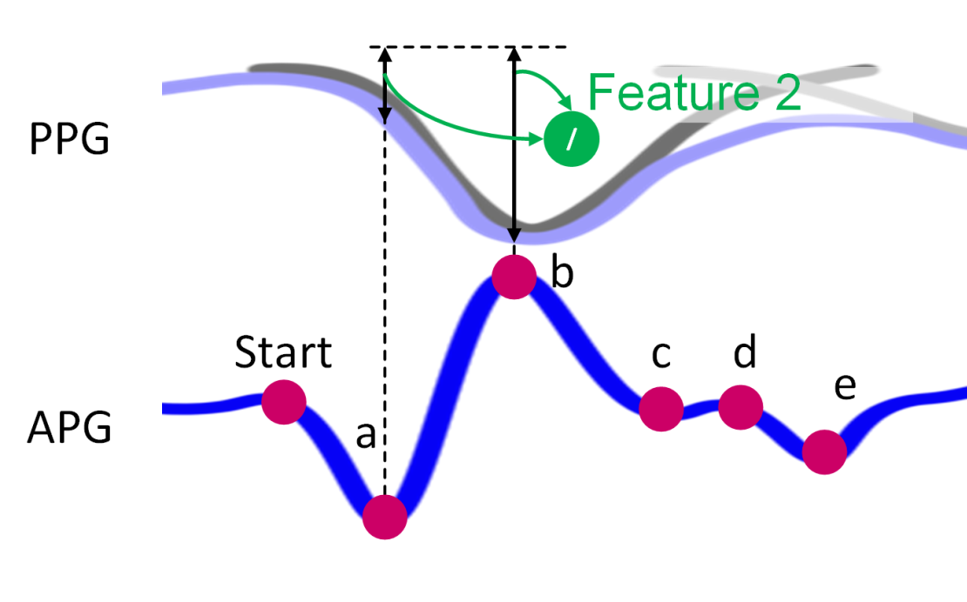
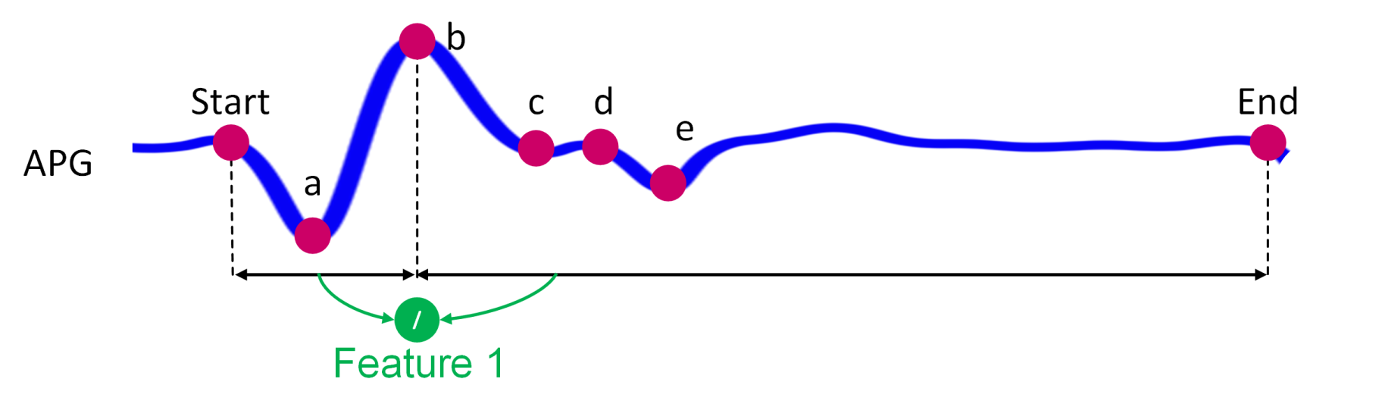
Device State Identification
Contact Pressure Estimation
Extract two unique features
Estimate contact pressure using Least-Squares Support Vector Machine (LSSVM)

Slide 13
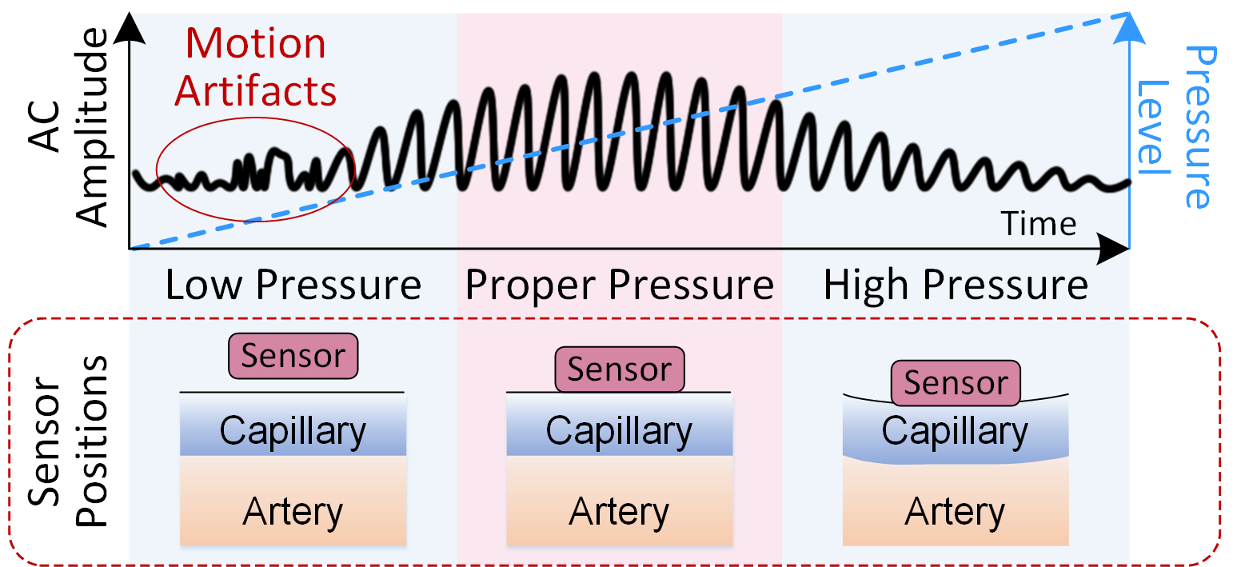
Device State Identification
Contact Pressure Qualification
Determine the Optimal Contact Pressure (OCP)
Guide the user to adjust the wristband to achieve OCP
OCP

Slide 14
Arterial Pulse Profiling
Noise Reduction
Bandpass filtering: 4th-order Butterworth, [0.5-8] Hz
Remove outlier pulses: percentage change method (Malik,1990)
Arterial Pulse Extraction
Green LED
Photodetector
Infrared LED
Infrared PPG
(Infrared PPG)
Capillaries
remove
Capillary Pulse
(Green PPG)
Arteries
Veins
Arterial Pulse

Slide 15
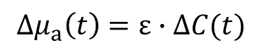
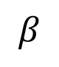
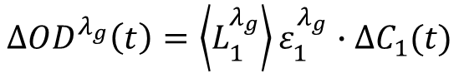
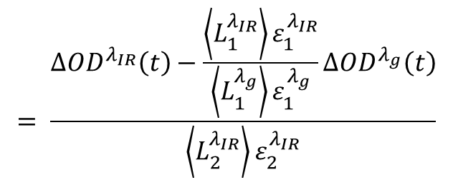
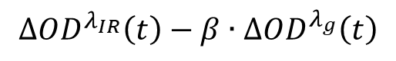
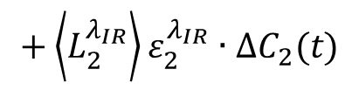
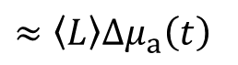
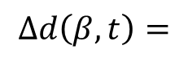
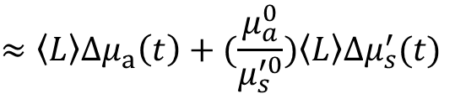
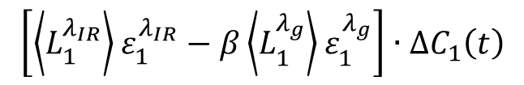
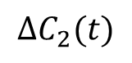
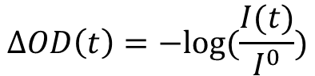
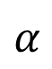
Arterial Pulse Profiling
$$∆OD^{λ_{g}}\left(t\right)=\left\langle L_{1}^{λ_{g}}\right\rangle ε_{1}^{λ_{g}}∙∆C_{1}(t)$$
$$∆OD^{λ_{IR}}\left(t\right)=\left\langle L_{1}^{λ_{IR}}\right\rangle ε_{1}^{λ_{IR}}∙∆C_{1}(t)+\left\langle L_{2}^{λ_{IR}}\right\rangle ε_{2}^{λ_{IR}}∙∆C_{2}(t)$$
$$∆C_{2}(t)$$
$$= \frac{∆OD^{λ_{IR}}\left(t\right)−\frac{\left\langle L_{1}^{λ_{IR}}\right\rangle ε_{1}^{λ_{IR}}}{\left\langle L_{1}^{λ_{g}}\right\rangle ε_{1}^{λ_{g}}}∆OD^{λ_{g}}\left(t\right)}{\left\langle L_{2}^{λ_{IR}}\right\rangle ε_{2}^{λ_{IR}}}$$
$$β$$
Green LED
Photodetector
Infrared LED
$$α$$
Capillaries
Optical Density Modeling：
$$∆OD\left(t\right)=−log⁡(\frac{I(t)}{I^{0}})$$
$$∆d\left(β,t\right)=$$
$$\left[\left\langle L_{1}^{λ_{IR}}\right\rangle ε_{1}^{λ_{IR}}−β\left\langle L_{1}^{λ_{g}}\right\rangle ε_{1}^{λ_{g}}\right]∙∆C_{1}\left(t\right)$$
$$∆OD^{λ_{IR}}\left(t\right)−β∙∆OD^{λ_{g}}\left(t\right)$$
Arteries
$$≈\left\langle L\right\rangle ∆μ_{a}\left(t\right)+(\frac{μ_{a}^{0}}{μ_{s}^{′0}})\left\langle L\right\rangle ∆μ_{s}^{′}(t)$$
$$+\left\langle L_{2}^{λ_{IR}}\right\rangle ε_{2}^{λ_{IR}}∙∆C_{2}(t)$$
Veins
$$≈\left\langle L\right\rangle ∆μ_{a}\left(t\right)$$
$$∆μ_{a}\left(t\right)=ε∙∆C(t)$$

Slide 16
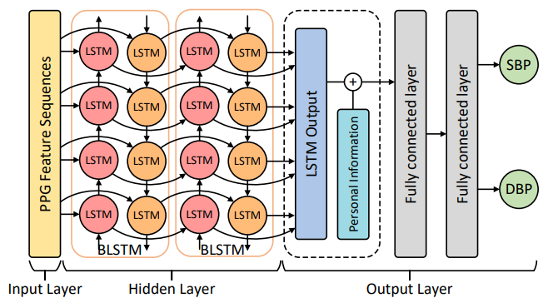
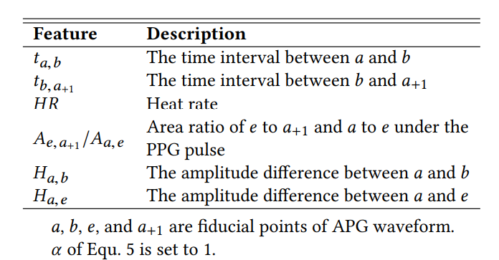
Continuous ABP Monitoring
Requiring sufficient training data

Slide 17
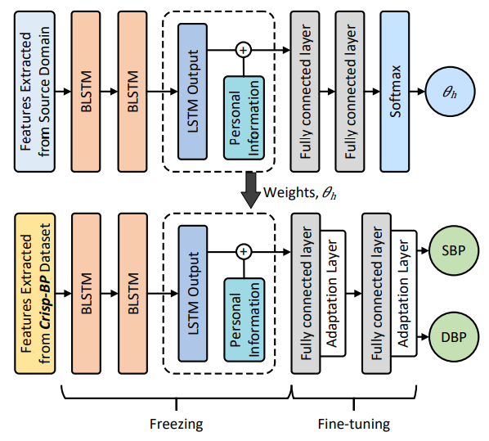
Continuous ABP Monitoring
Boosting the ABP Monitoring
weights & bias

Slide 18
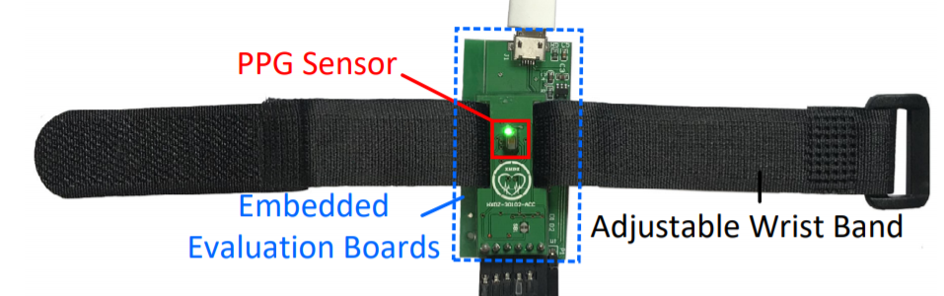
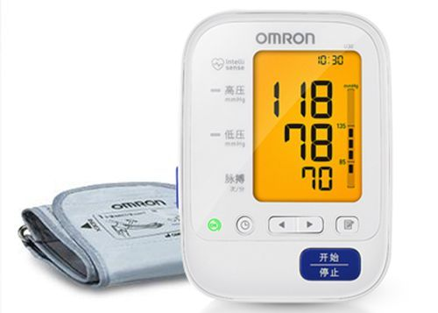
Evaluation
Setup
PPG-based prototype
Data Collection
35 participants (17 male, 18 female, aging between 19 to 50)
10 sessions
Continuous monitoring experiment
Various PPG sensors, sampling frequencies, contact pressures, and network structures
Ground Truth
Omron U30 device
Standard validation procedure
prototype
Arm-cuff BP monitoring device

Slide 19
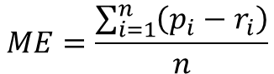
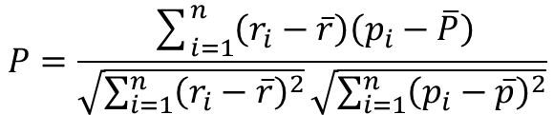
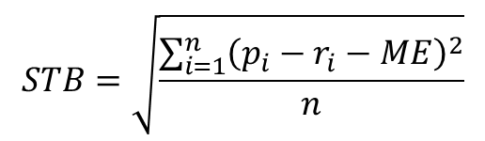
Evaluation
Metrics
Mean error
Standard deviation
Sample Pearson’s correlation coefficient
$$ME=\frac{\sum_{i=1}^{n}{\left(p_{i}−r_{i}\right)}}{n}$$
$$STB=\sqrt{\frac{\sum_{i=1}^{n}{{\left(p_{i}−r_{i}−ME\right)}^{2}}}{n}}$$
$$P=\frac{\sum_{i=1}^{n}{\left(r_{i}−\overline{r}\right)\left(p_{i}−\overline{P}\right)}}{\sqrt{\sum_{i=1}^{n}{{\left(r_{i}−\overline{r}\right)}^{2}}}\sqrt{\sum_{i=1}^{n}{{\left(p_{i}−\overline{p}\right)}^{2}}}}$$

Slide 20
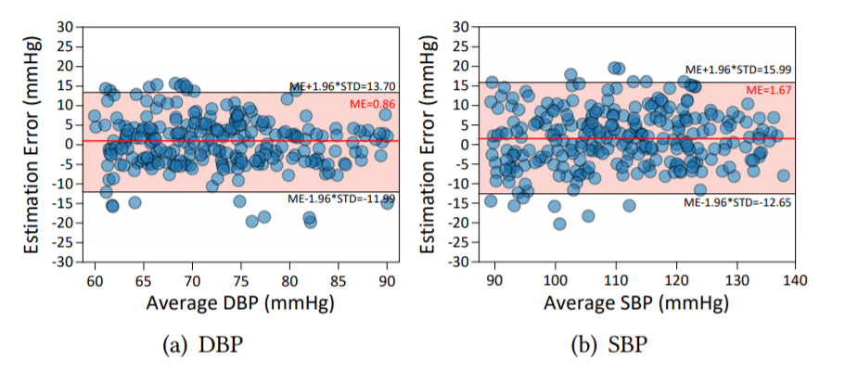
Overall Performance
Bland–Altman diagram of DBP and SBP
Mean error：
DBP 0.86 mmHg
SBP 1.67 mmHg
Standard deviation
DBP 6.55 mmHg
SBP 7.31 mmHg

Slide 21
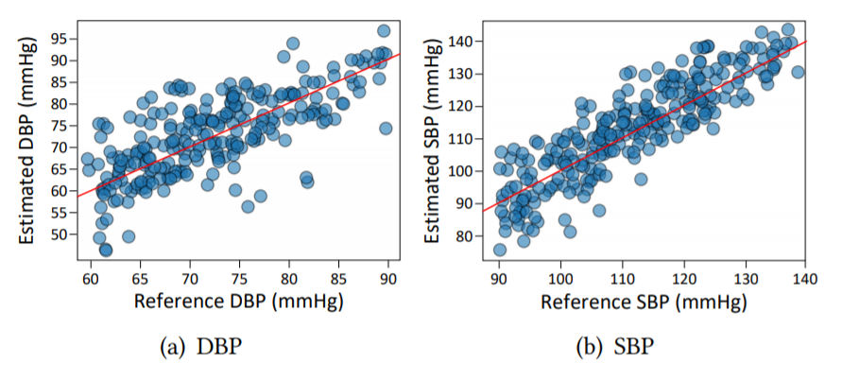
Overall Performance
Correlation diagram of DBP and SBP
Sample Pearson’s correlation coefficient
DBP 0.88
SBP 0.82

Slide 22
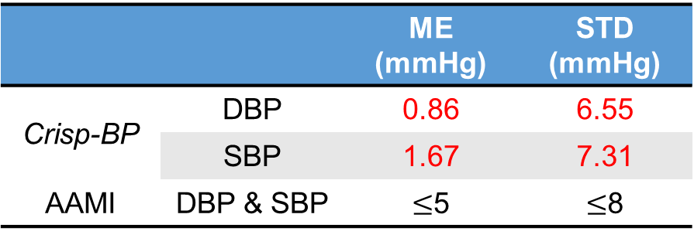

Overall Performance
Association for the Advancement of Medical Instruments
 |  | ME (mmHg) | STD (mmHg)
Crisp-BP | DBP | 0.86 | 6.55
 | SBP | 1.67 | 7.31
AAMI | DBP & SBP | $≤$5 | $≤$8
 |  | Cumulative Error Percentage
 |  | $≤$5 mmHg | $≤$10 mmHg | $≤$15 mmHg
Crisp-BP | DBP | 76.73% | 91.43% | 97.96%
 | SBP | 65.66% | 87.17% | 96.23%
BHS | Grade A | 60% | 85% | 95%
 | Grade B | 50% | 75% | 90%
 | Grade C | 40% | 65% | 85%
Britain Hypertension Society

Slide 23

Comparison with Typical Related Works
Items | Glabella | SeismoWatch | Seismo | Naptics | eBP | Crisp-BP
Method | PTT | PTT | PTT | PTT | CPA | RWTT
Subject | 4 | 13 | 9 | 6 | 35 | 35
Device | Glasses | Wristband | Phone | Shorts | In-ear | Wristband
Auxiliary Tools | - | Accel | Accel | Accel,elec,oxi | Balloon | -
Passive Sensing |  |  |  |  |  | 
Scenario | Daytime | Instant | Instant | Night | Instant | Daytime & night
Comfort Level | High | Middle | Middle | Middle | Middle | High
SBP ME/STD (mmHg) | $±$10 | 4.8 | - | - | 1.8/7.2 | 1.67/7.31
DBP ME/STD (mmHg) | - | 2.9 | 1.3/6.9 | - | -3.1/7.9 | 0.86/6.55
PTT, CPA stand for pulse transit times, change of pulse amplitude, respectively. Accel, elec, and oxi represent accelerometer, electrodes, and oximeter, respectively

Slide 24

24-Hour Performance
24-hour performance
Mean error：
DBP <3.2 mmHg
SBP <3.2 mmHg

Slide 25

Conclusion
We propose an effective system to monitor ABP.
We design a set of techniques to ensure accurate ABP measurements.
Evaluation Results are promising.
More details？
Yetong Cao, Huijie Chen, Fan Li, Yu Wang,
Crisp-BP: Continuous Wrist PPG-based Blood Pressure Measurement,
In MobiCom 2021, New Orleans, United States, January 31 - February 04 2022

Slide 26
Thanks!
Thanks!
Thanks!
&
&
&
Questions
Questions
Questions
Yetong Cao
yetongcao@bit.edu.cn

